Slide 1
NPRE 321 Introduction to Plasmas and their Applications
Research Associate Professor Daniel Andruczyk
Hybrid Illinois Device for Research and Applications
Center for Plasma Materials Interactions
Department of Nuclear, Plasma and Radiological Engineering
University of Illinois Urbana-Champaign
3 Hours of Lectures per week
Including Practicums

Slide 2
LECTURE 16
PRACTICUM II
Describing processing and industrial plasmas

Slide 3
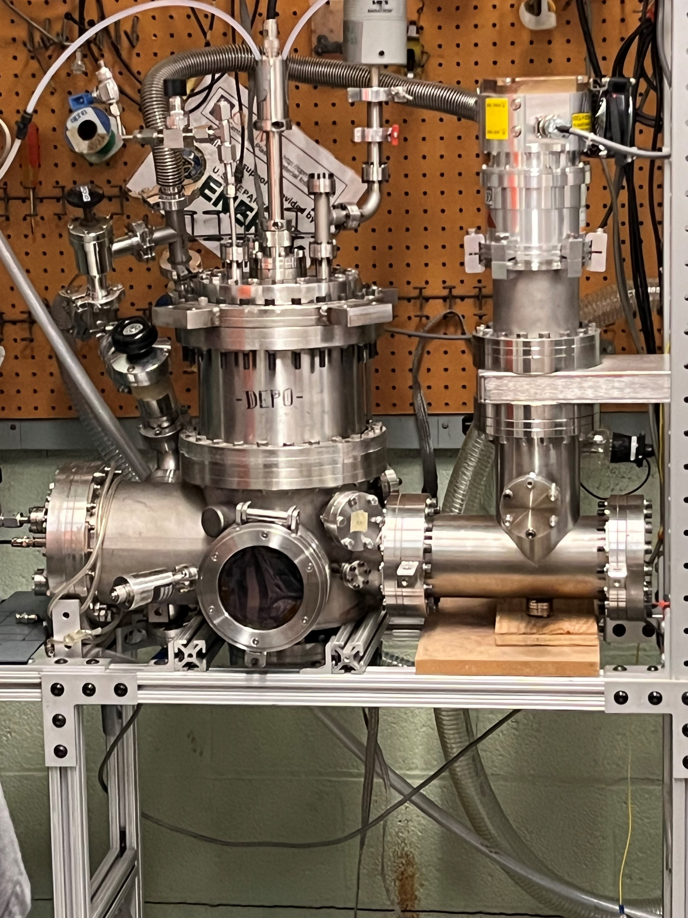
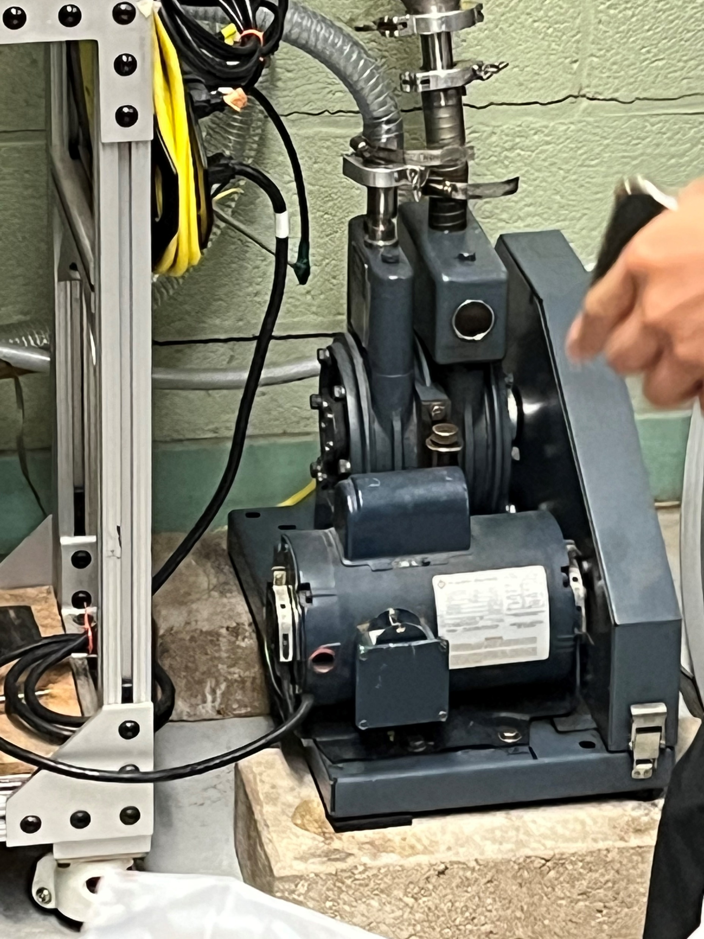
Practicum Laboratory #1: DESCRIBING A BASIC PLASMA DISCHARGE Student Name: Joseph Specht (jspecht3) Practicum Date: October 4, 2023
Introduction: (Description of the apparatus and experiment being shown)
This experiment uses a magnetron sputtering contraption to deposit copper onto dimes. Pictured left is the full setup, which includes a vacuum chamber with a viewing port, a baratron inside said vacuum chamber, a rough pump (pictured bottom right), a turbo pump, and a DC power supply running everything.
The purpose of this experiment is to deposit copper from a plate attached to the bottom of the baratron. Before any deposition, the vacuum chamber must be pumped to ~80 mTorr with a rough pump before a turbo pump can be used.
Once a sufficient pressure (~10e-5 torr) is established, the argon gas in let into the chamber and ionized with a DC power supply. This argon plasma knocks copper atoms off the large plate attached to the baratron and deposits them on the dimes.

Slide 4
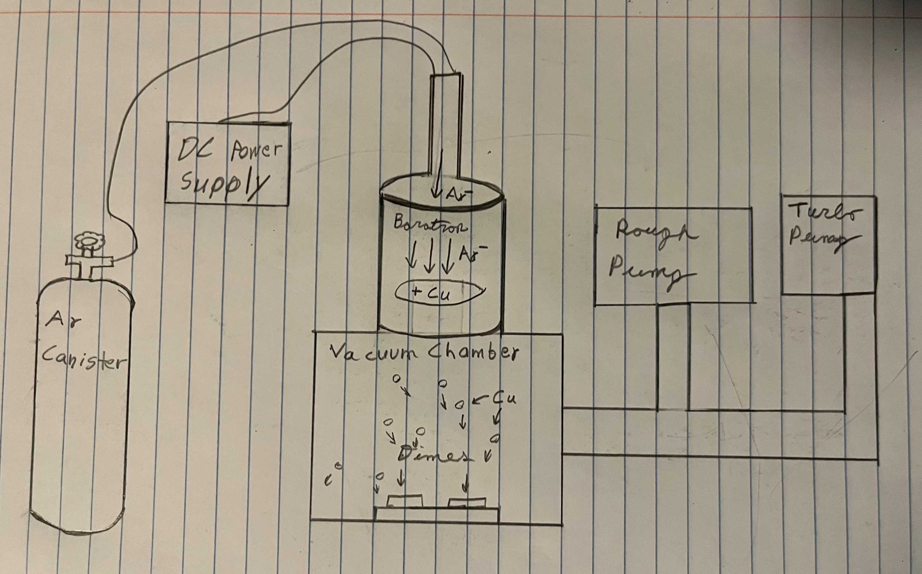
Introduction (Continued):

Slide 5

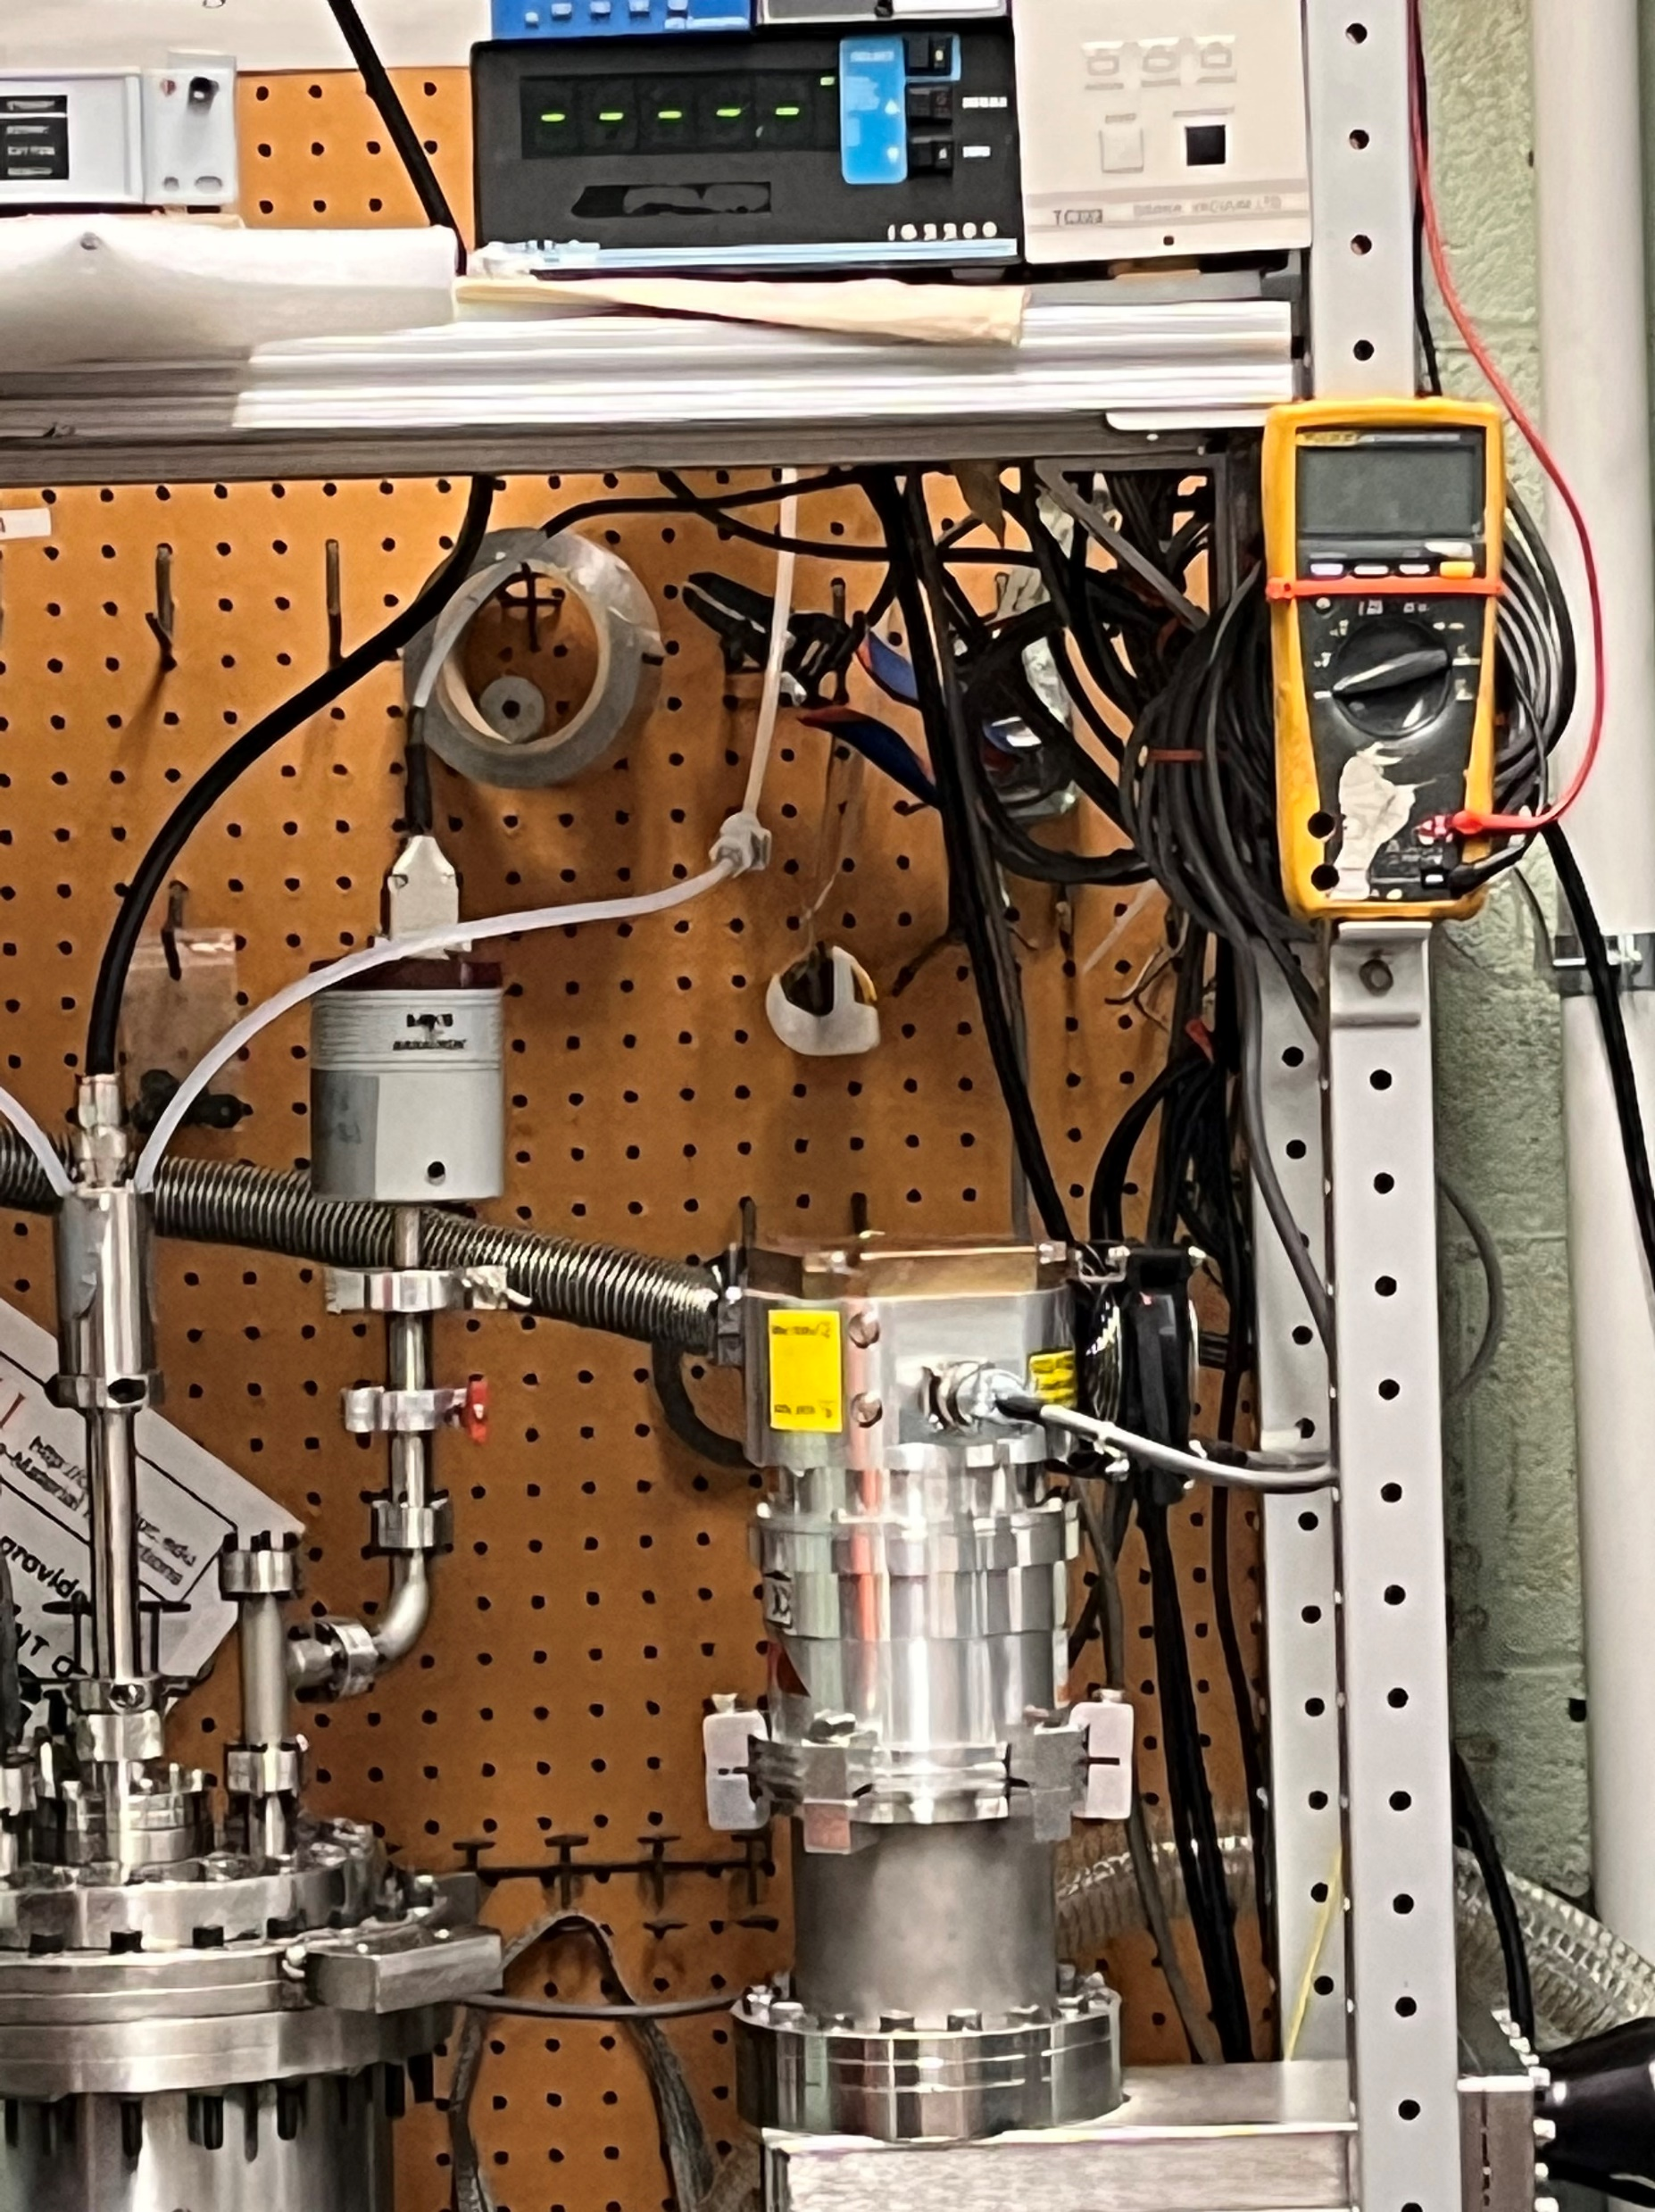

Observations: (Describe what you saw in the laboratory today, describe equipment and other aspects, include diagrams)
Rough Pump (Below)
The rough pump is used in the pressure regime of atmospheric pressure down to ~80 mTorr where the turbo pump then takes over. This pump is used to take the gas in the vessel and reject it so the plasma can have a favorable environment for the experiment we are performing.
Turbo Pump (Above)
This pump takes over for the rough pump ~80 mTorr for two reasons. The first is the rough pump loses efficiency the lower the pressure gets and only has enough power to reach a certain level. The second is the turbo pump would be ripped to shreds internally if it was exposed to gas density anywhere close to atmosphere. This pump is incredibly powerful and can get the vessel down to ~10e-5 torr.
Vacuum Chamber (Above)
The vacuum chamber is an airtight vessel meant to withstand atmospheric pressure enough to maintain a near vacuum. The gaskets connecting each part of the chamber are made of metal, so the entire vessel can be heated

Slide 6
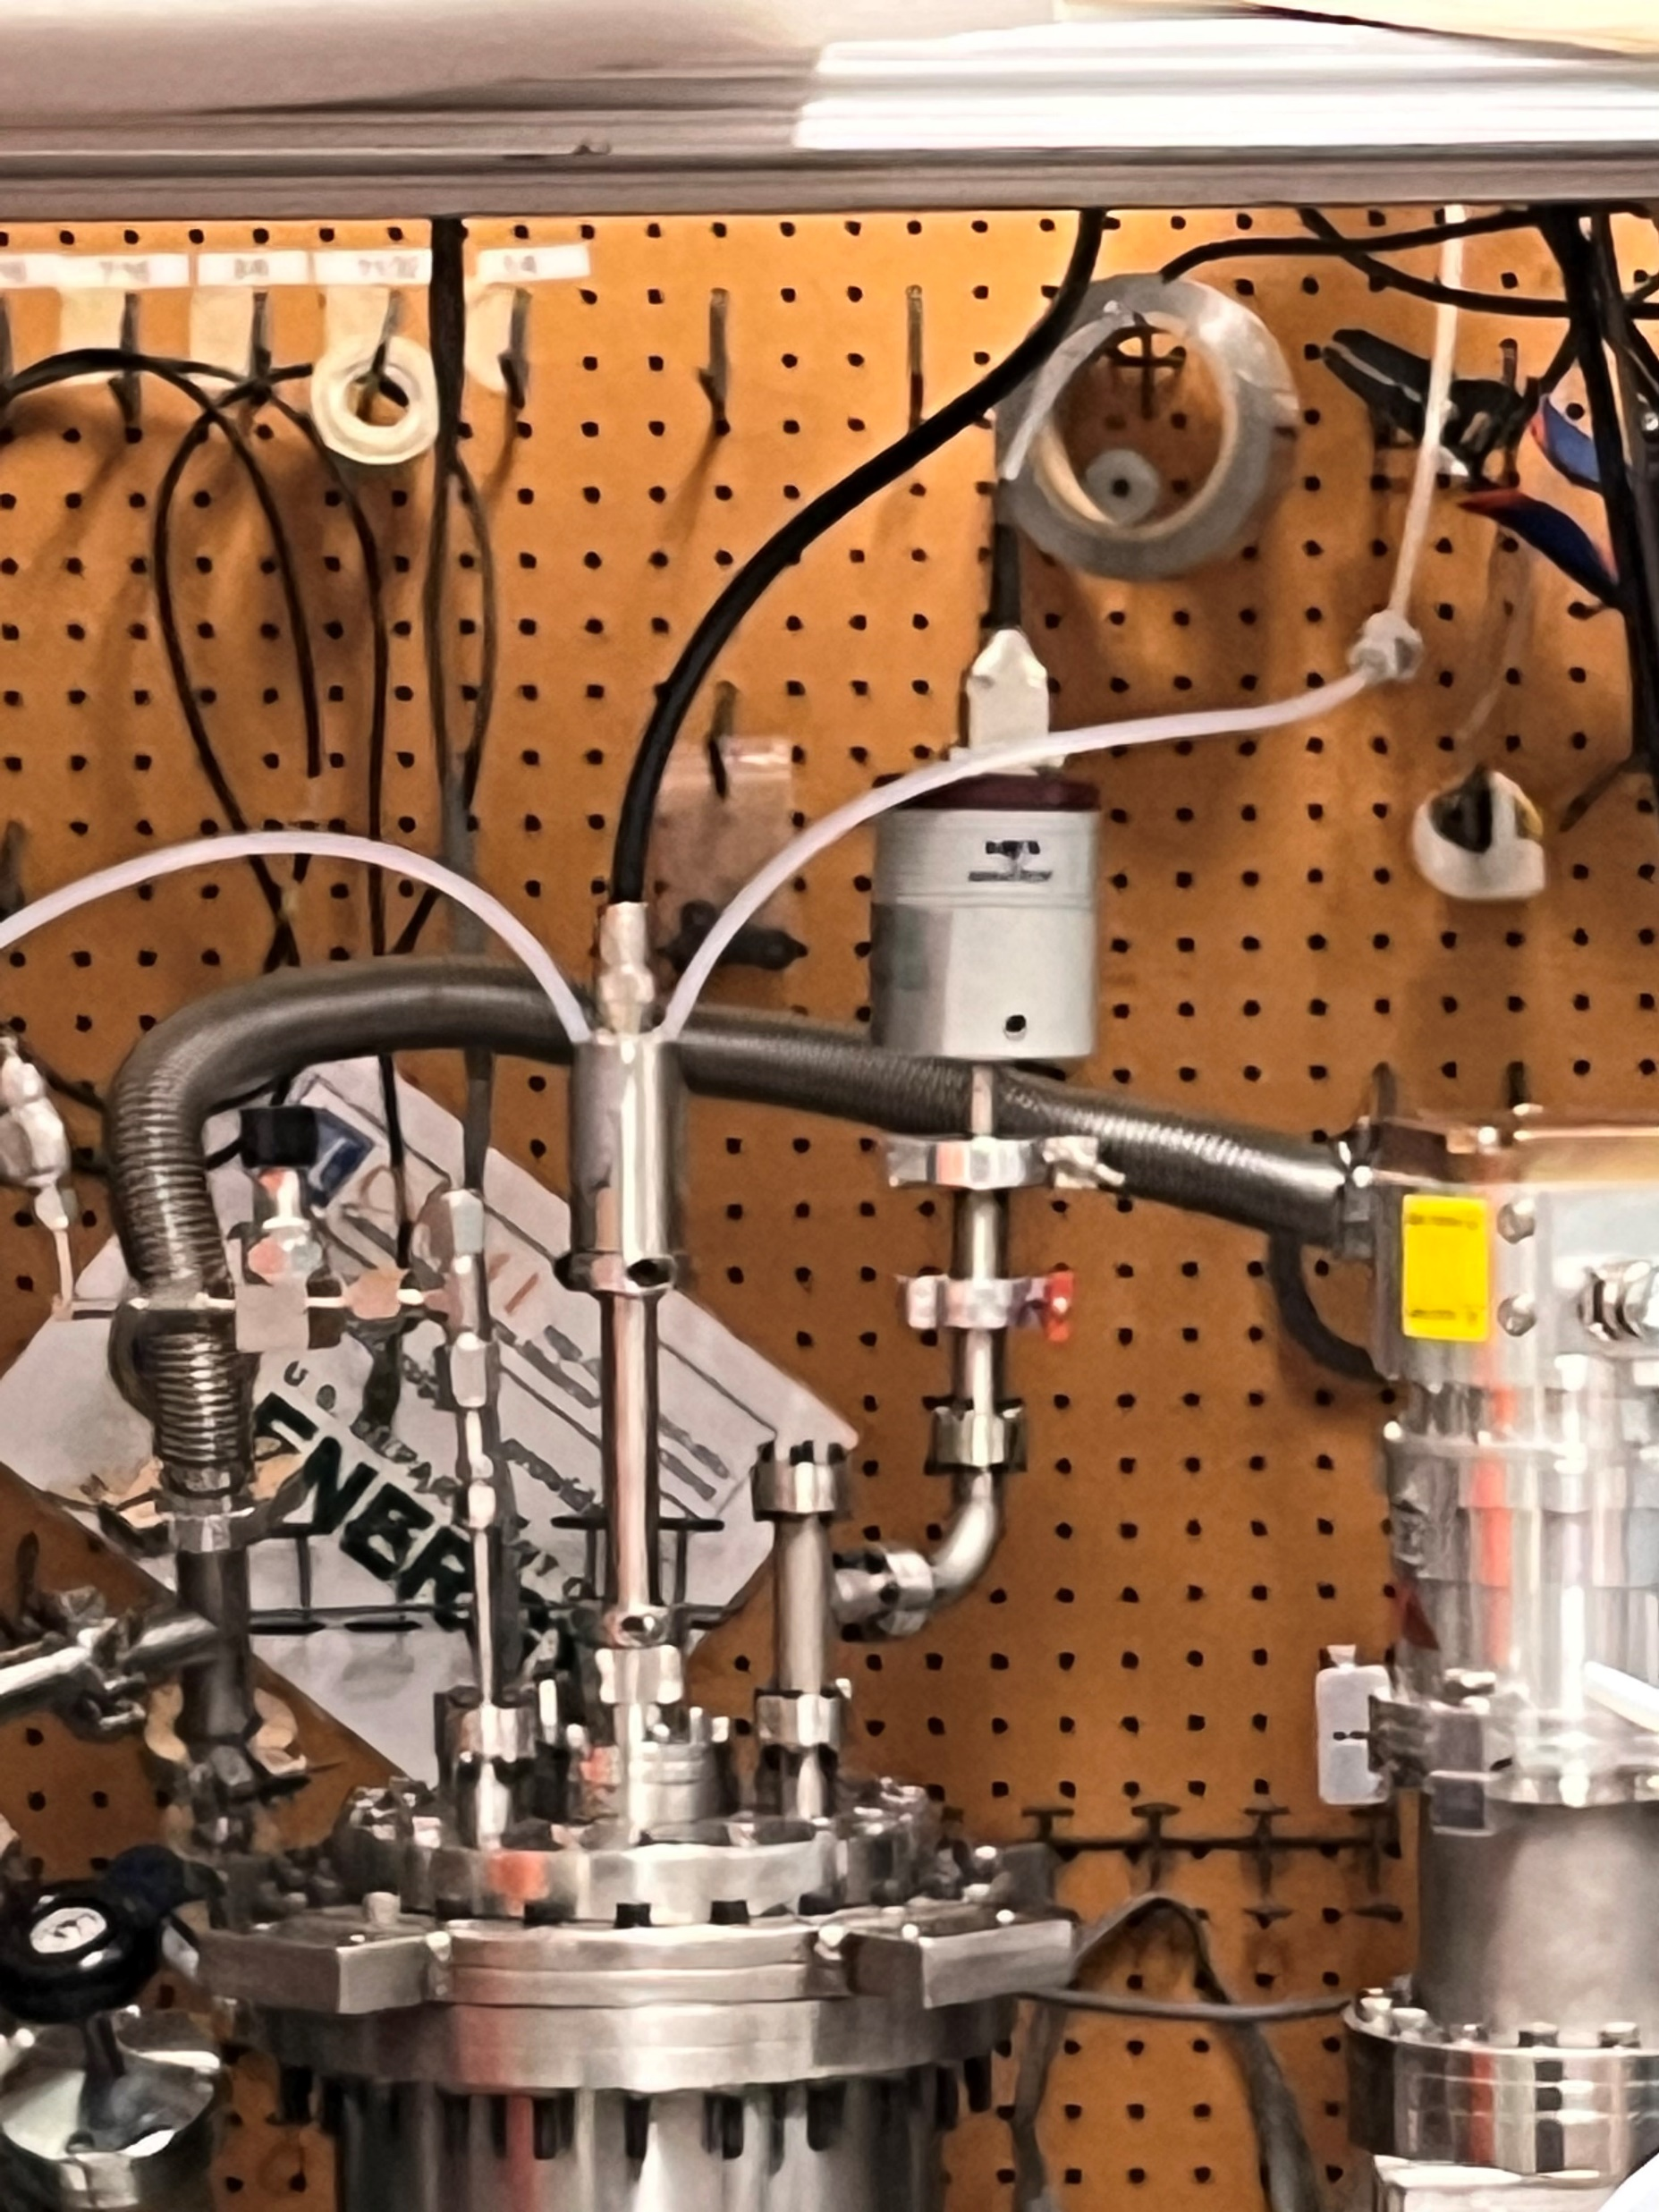
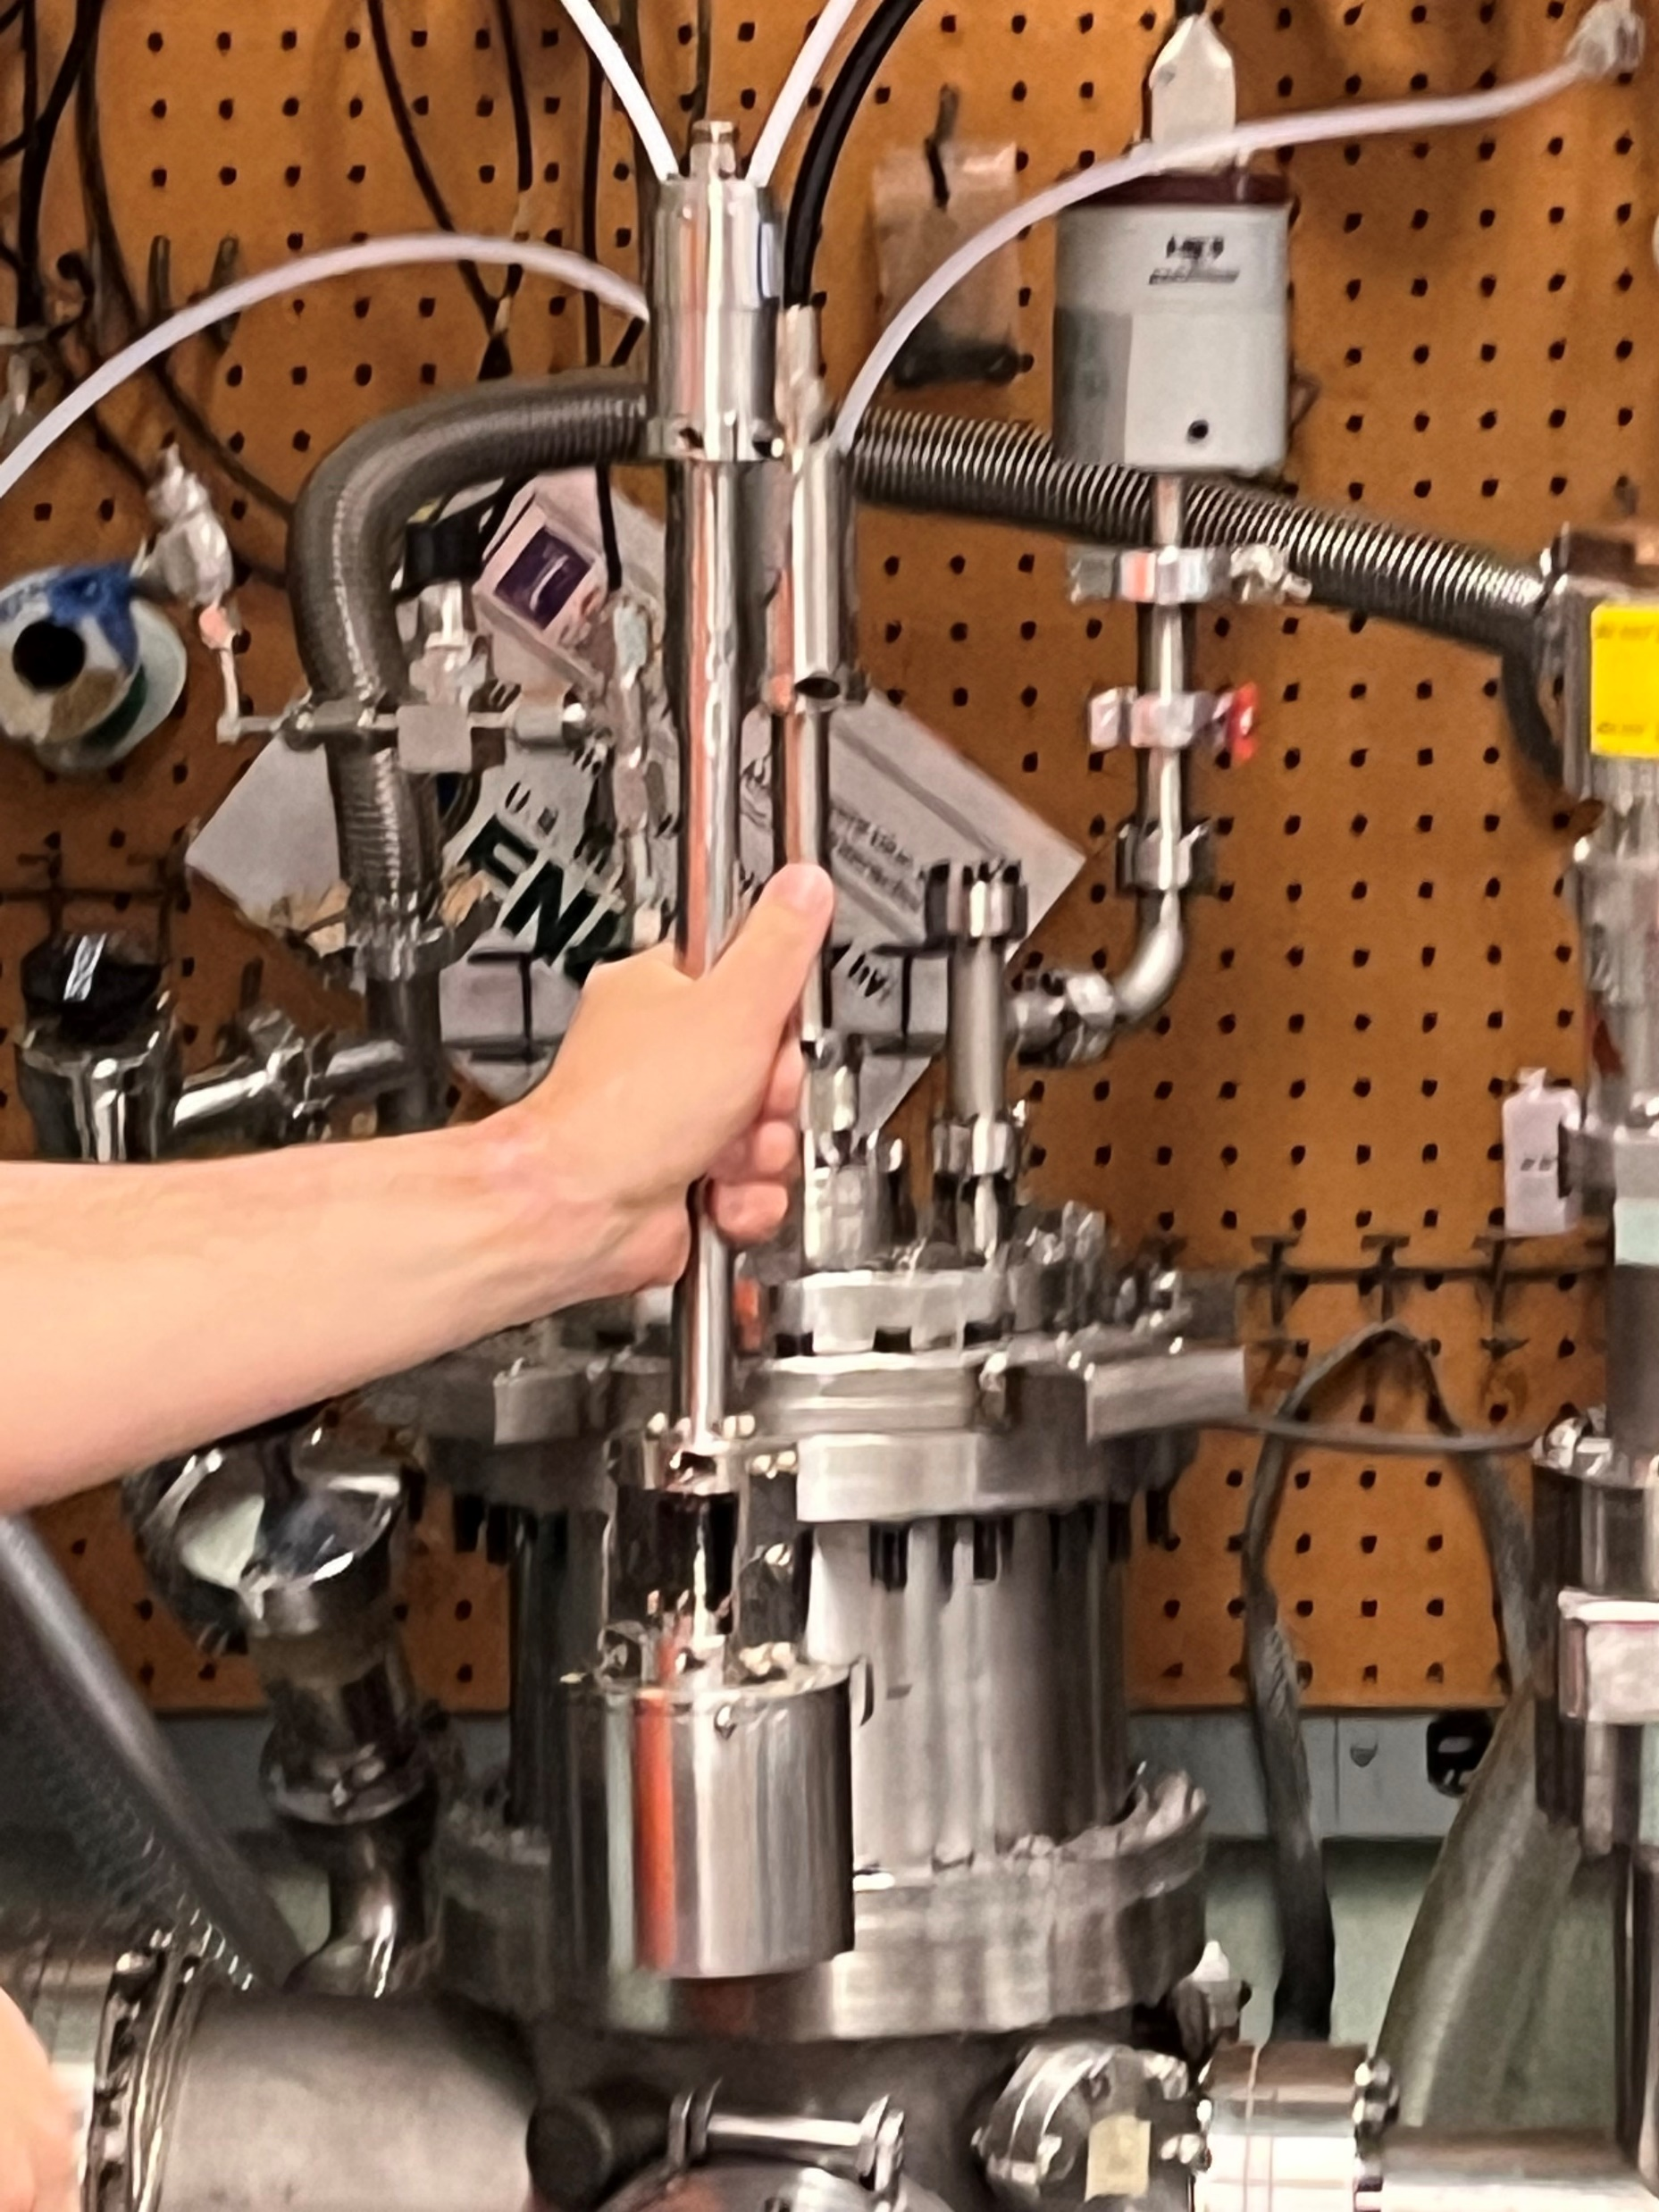
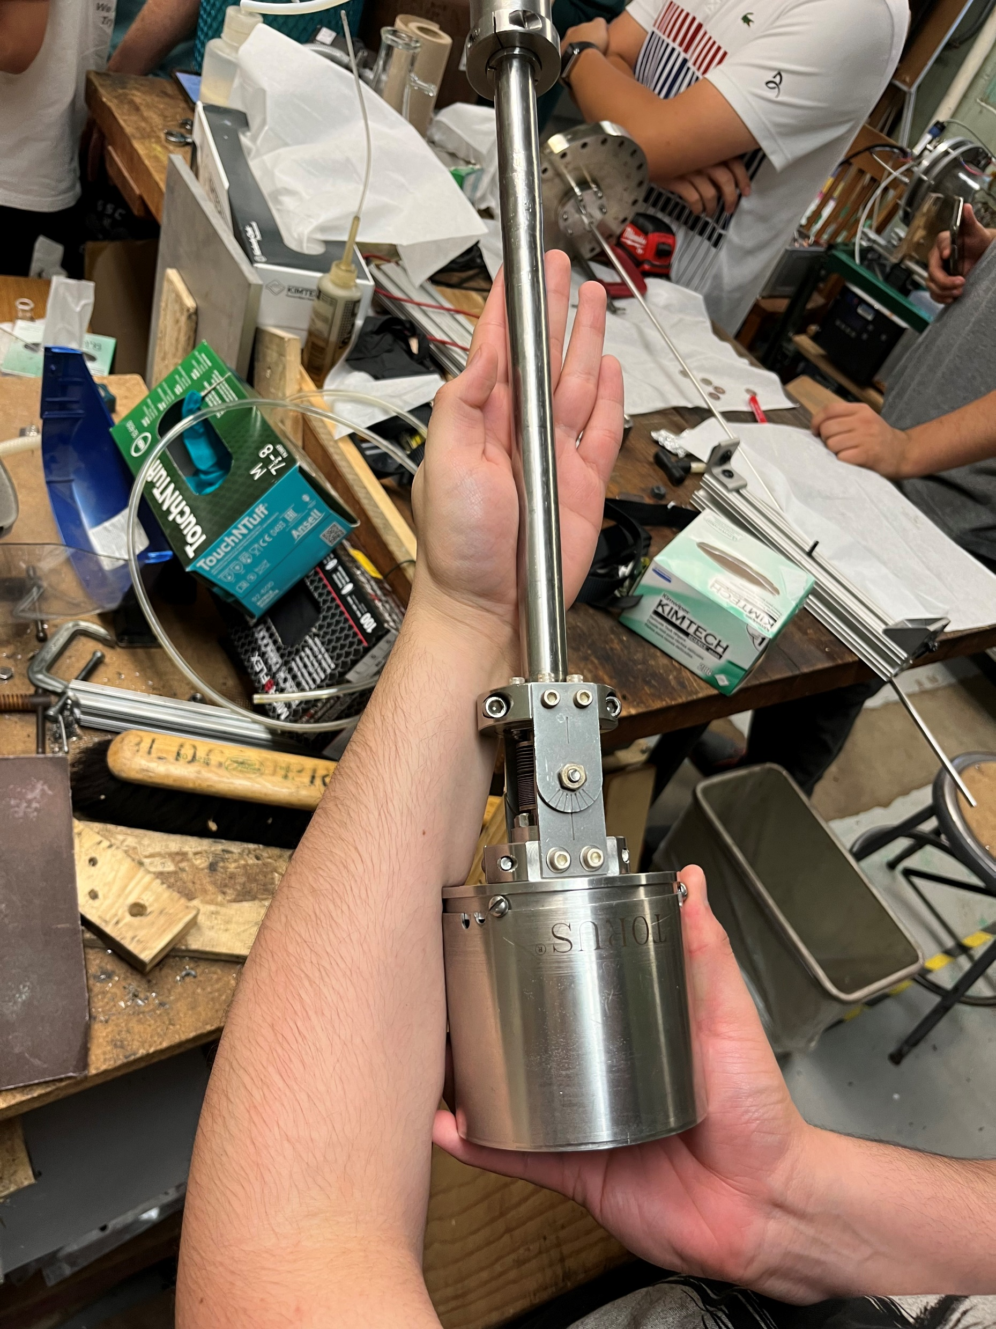
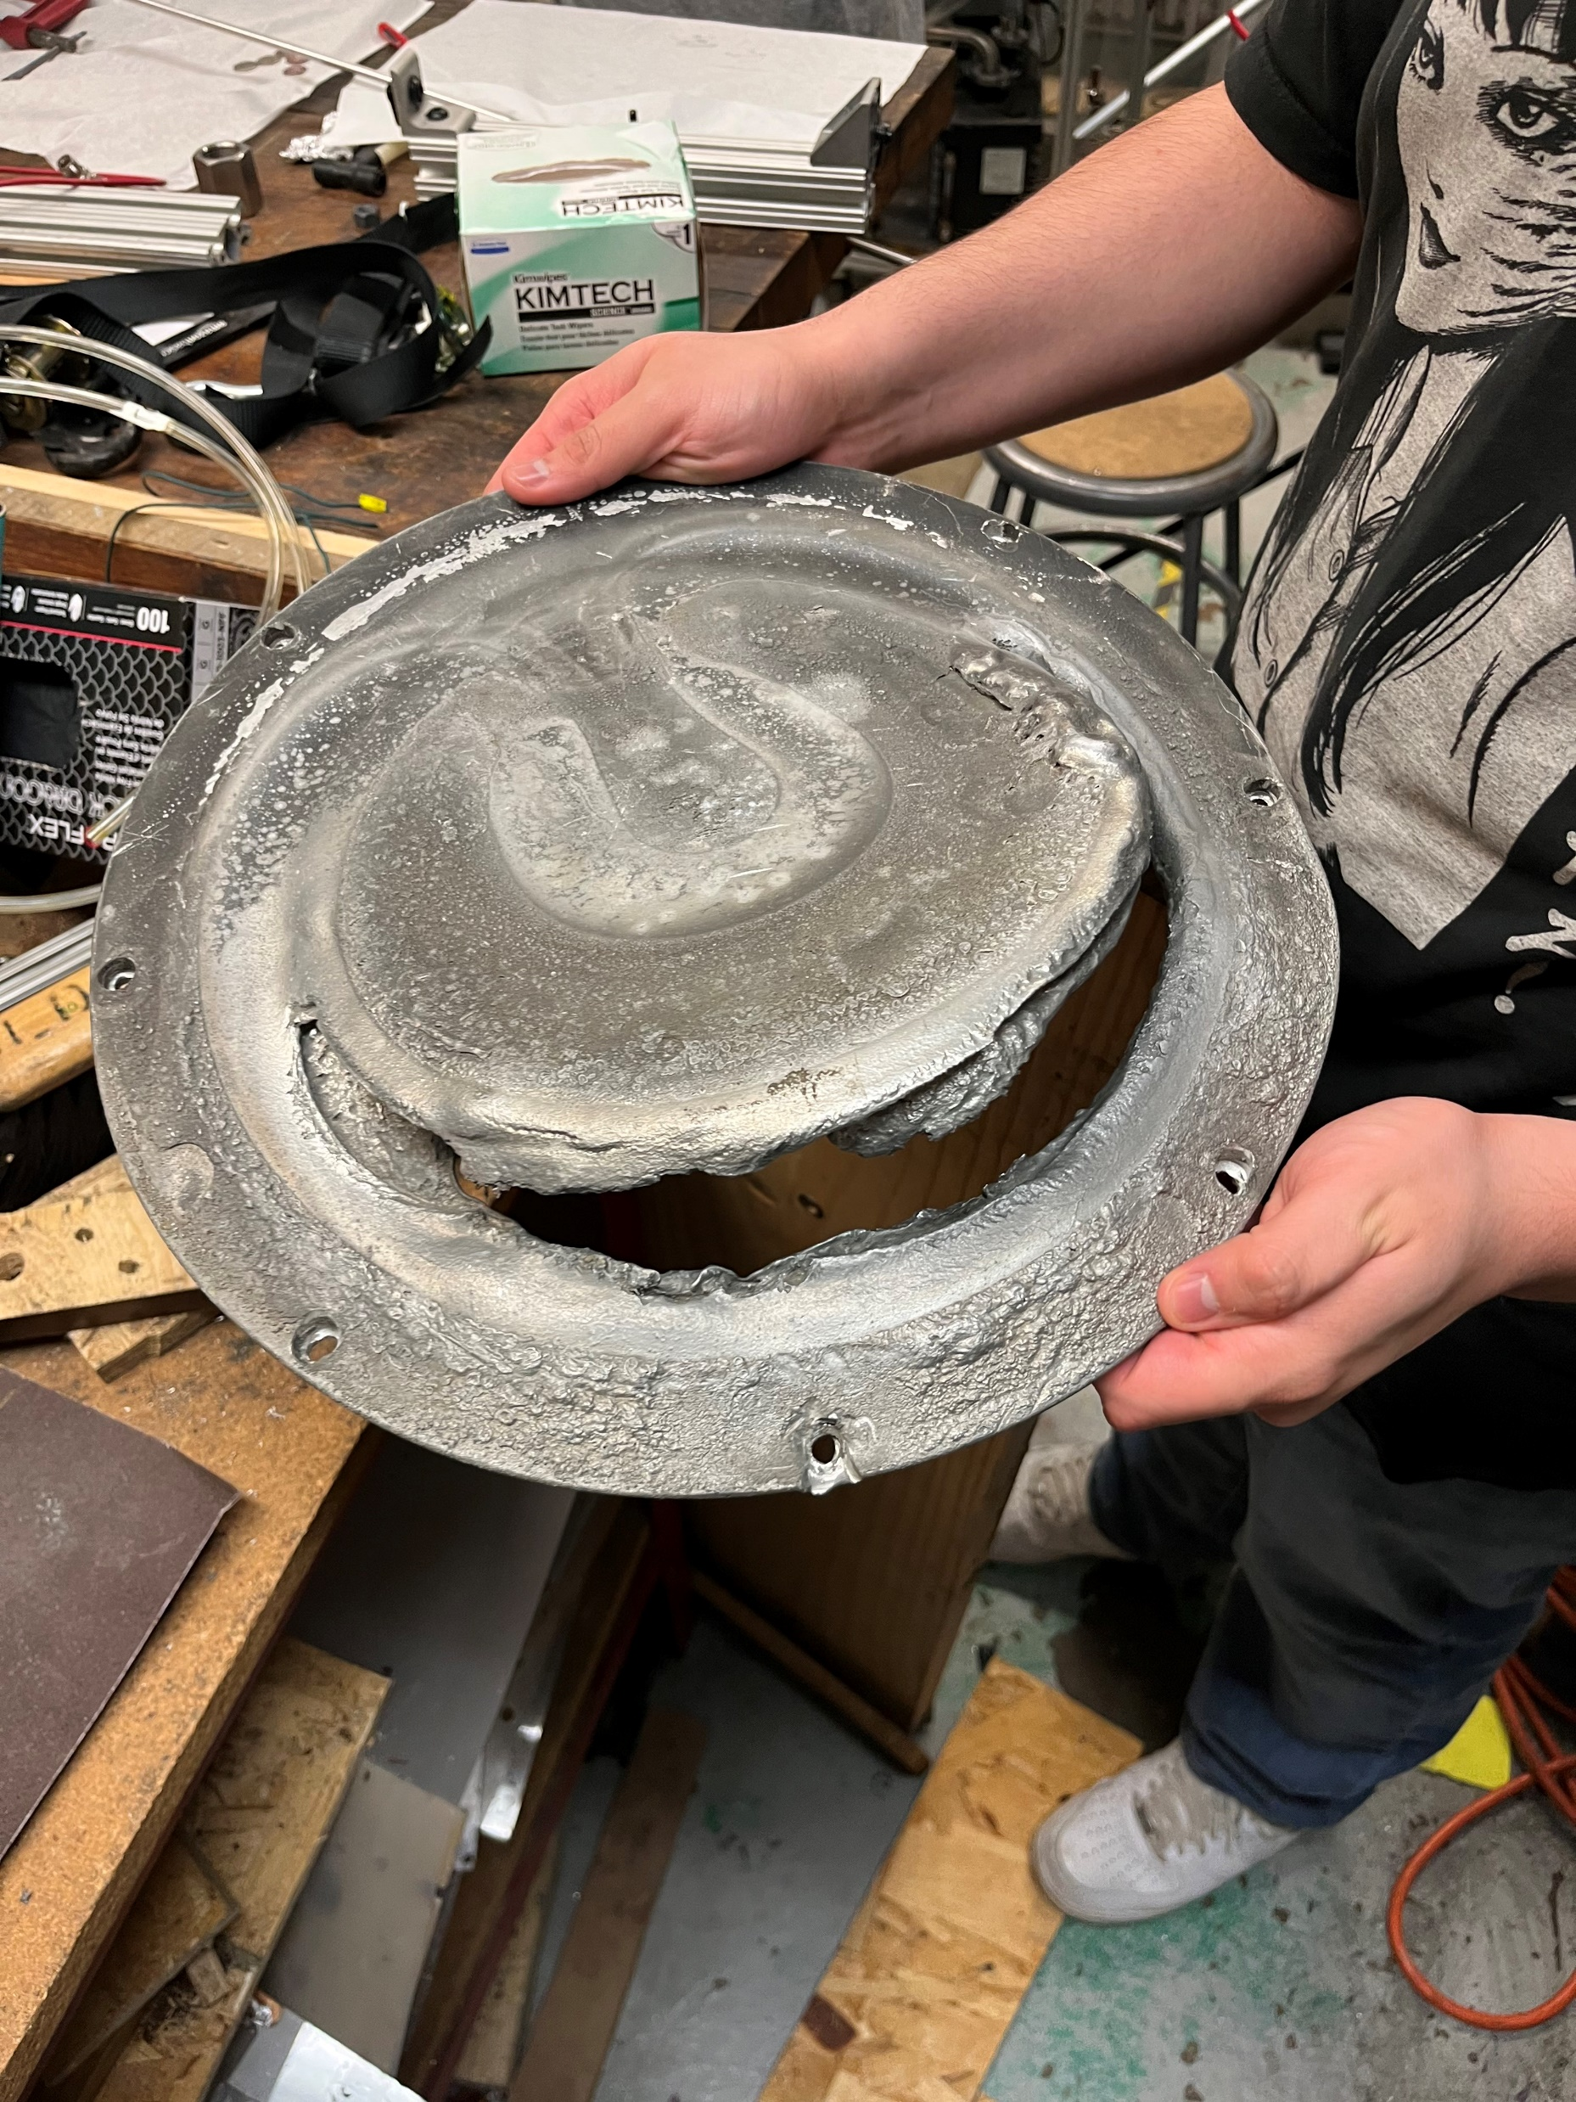
Observations (continued):
Cathode (Below)
The cathode in this experiment was a smaller and copper version of the tin one below, but the overall idea is the same. This disc was not cooled properly and, as a result, has been destroyed. However, the separate circular regions in the disc are still apparent.
Baratron (Left, Top, Right)
The baratron is a device that is hooked up to an argon line in and a DC power supply. The shaft on the upper half is used to channel the plasma in and the bottom cylinder is used to eject the cathode material, which is copper here. There are concentric rings of north and south magnets inside the cylinder that slot into the cathode. In this experiment, we only had a single ring outside the central circle, but on larger devices, multiple rings can be used for a more stable magnetic field.

Slide 7
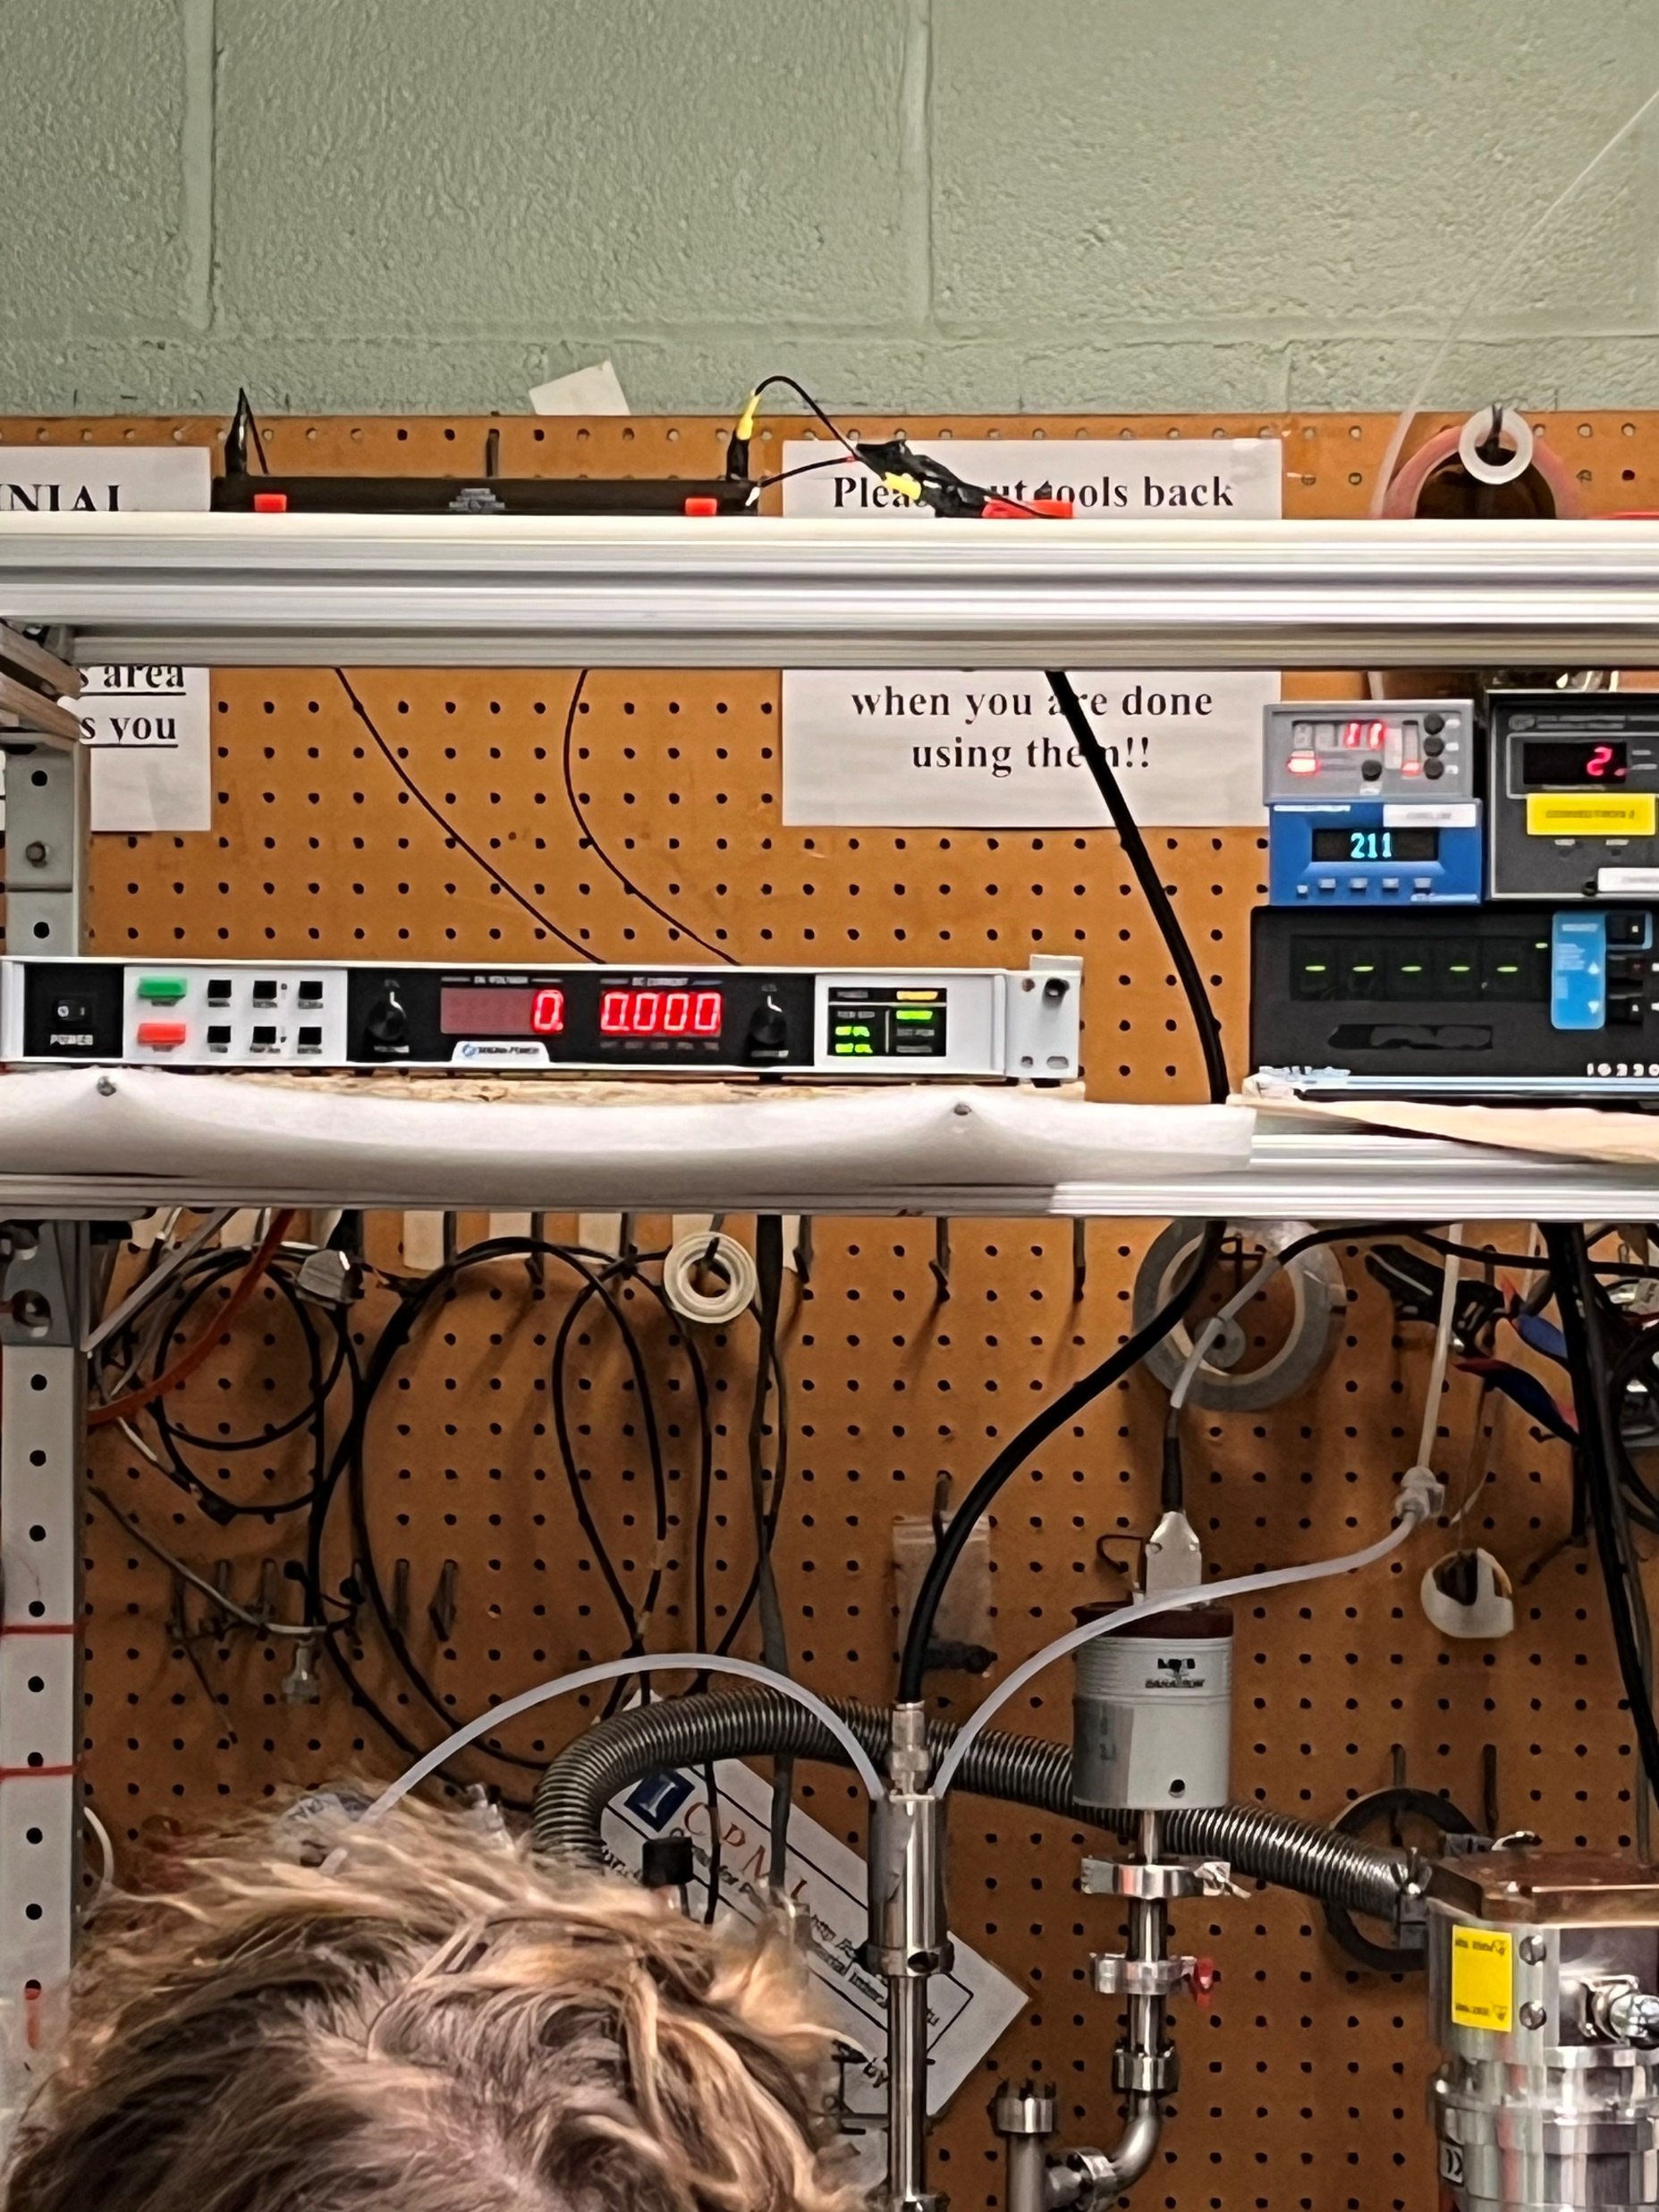
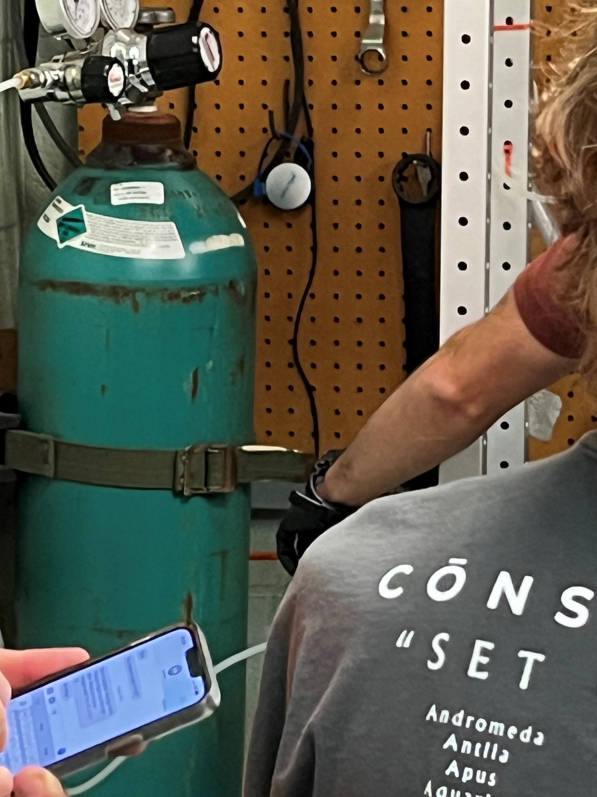
Observations (continued):
Lab Procedure
What we saw today was a vacuum being formed through the forced removal of gas in our air-tight vacuum chamber. This removal was done in two steps: rough removal using the rough pump and near-vacuum removal using the turbo pump.
There were three different ways to measure the pressure: a diaphragm in the baratron, an ion gauge, and another I forgot about. The diaphragm in the baratron uses the force of the gas molecules hitting it to calculate the pressure. The ion gauge uses a tungsten filament, which has a current running through it, to measure the current generated in the surrounding gas. The ion gauge can only be used in the near vacuum stage as it is very sensitive.
Once a vacuum was established, the power supply and argon inlet were turned on to create a plasma flowing into the baratron. This plasma was then shot at a cathode made of copper to eject the copper downwards towards the target dimes. These dimes were then coated with a thin layer of copper.
Argon Canister (Below)
This is the source of the anode (argon) in this experiment. This argon flows into the baratron and gets ionized by the DC power supply
DC Power Supply (Above)
This power supply supplies the main voltage to ionized the plasma and to bias the cathode (copper plate).

Slide 8
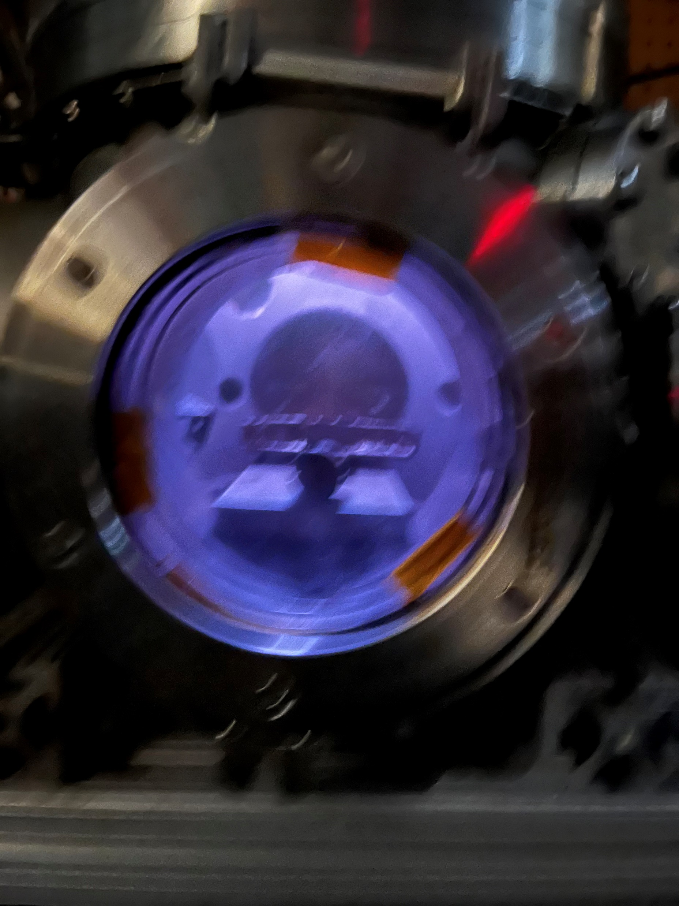
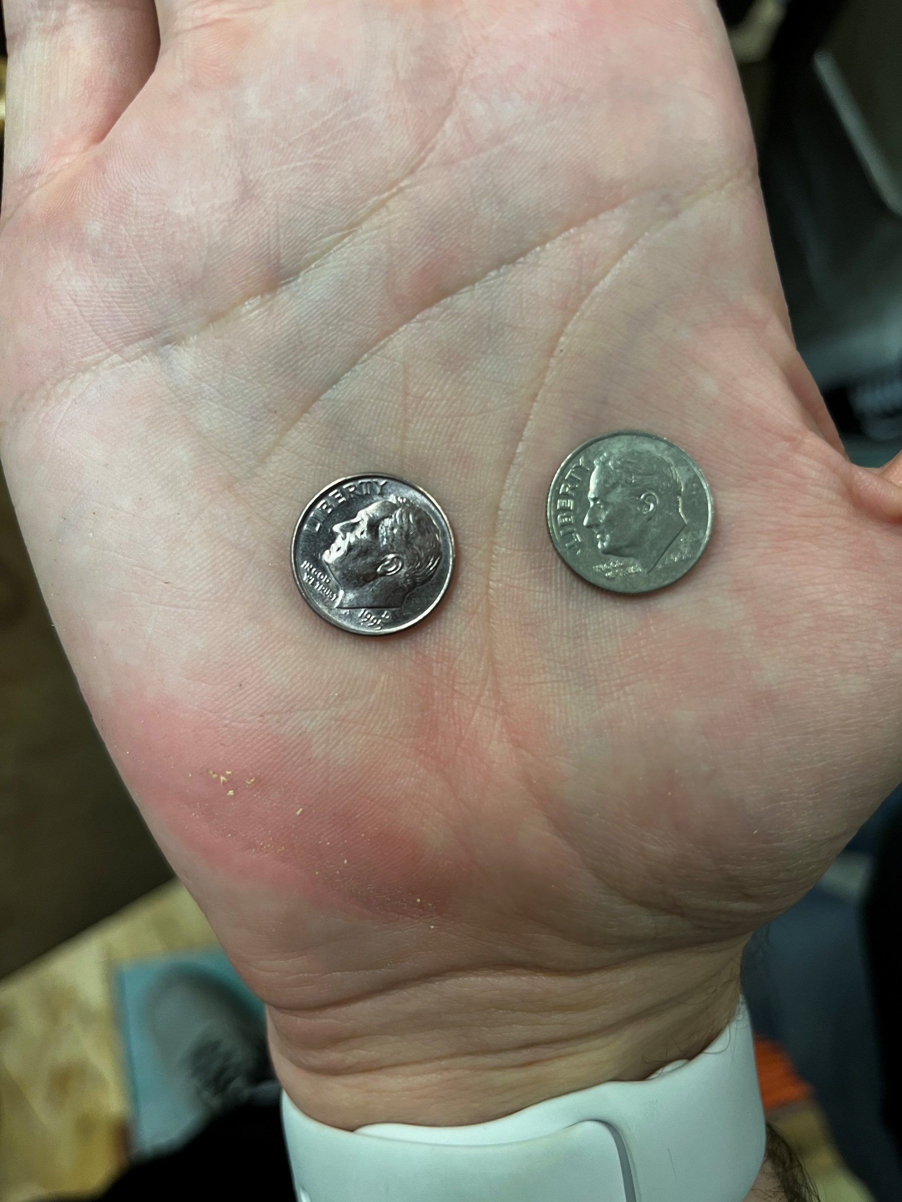
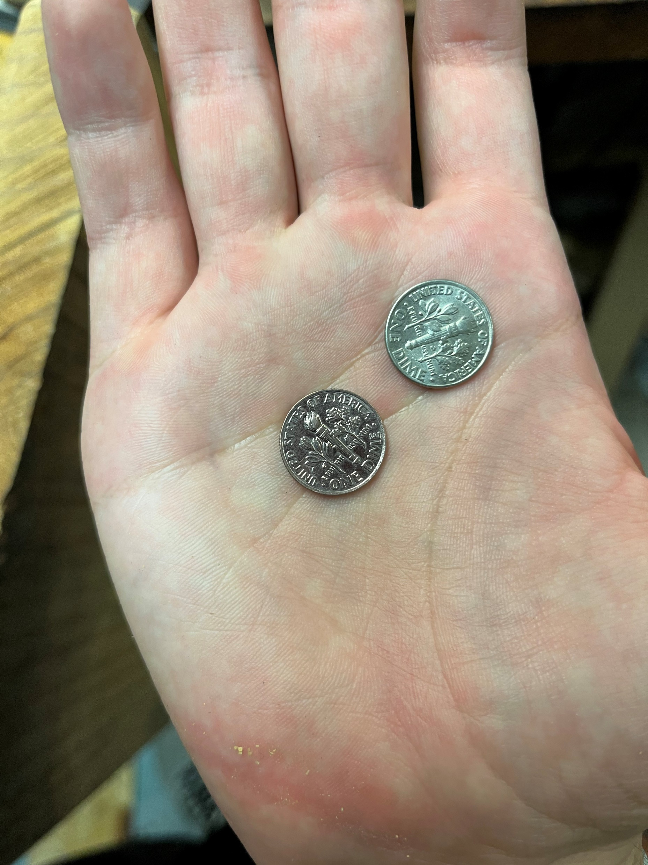
Discussion: (Discuss the results that were shown today, include any analysis)
The results of this experiment were dimes that were thoroughly coated with a very thin and fragile layer of copper on one face and an unaltered face on other side (left). The copper coated coins are differentiable due to their darker shade and browner color. However, this layer was fairly easily removed when I rubbed my finger across it.
I believe the layer integrity could be improved with longer exposure, a more thorough cleaning of the chamber walls or dimes, or lower pressure. However, the biggest improvement could probably be made if the copper atoms’ energy was increased substantially as they would be able to deform the dime’s surface more and form a deeper trench. This could cause problems to arise if the preservation of miniscule surface detail is more important than the surface plating.
Blurriest Picture Of a Plasma Chamber Ever Taken (Above)

Slide 9
Summary: (Summarize what the laboratory was about and how it ties into lectures)
This lab was a demonstration of how magnetron sputtering works. The vacuum chamber was drawn to a rough vacuum with a rough pump before a turbo pump dropped the pressure to the desired region. Then, an argon plasma was shot at a copper plate in an attempt to knock copper atoms free and deposit them on a dime.
An important tie to lecture involves mean free path (MFP). The longer the MFP, the more desirable it was. The reason to draw a vacuum in the first place was to increase the MFP as the high density of air molecules would slow the copper atoms on their way down to the surface. An excellent target MFP would be ~1.5x the distance from the cathode to the substrate. This way you could ensure most of the copper reaches the face.
Another important tie in would be how the ion gauge could be used to detect current flowing through a plasma. This device shows how plasma can be used to generate a measurable current.
A final tie in would be that of positively biasing the copper cathode so the negative anode (argon plasma) would be more attracted to it. This simply shows that it is better to have oppositely charged particles colliding if maximum impulse imparted on the cathode is desired.

